Slide 1

Azure Cosmos DB Concepts

Slide 2
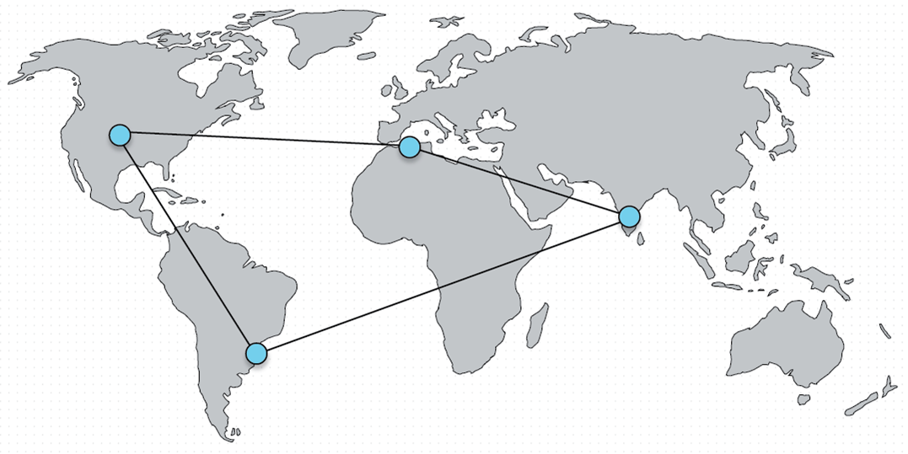
Global Distribution
Microsoft Azure is available globally in over 30 regions
Global distribution is a comparable concept to what replication is for relational databases
Don’t need complex configurations

Slide 3
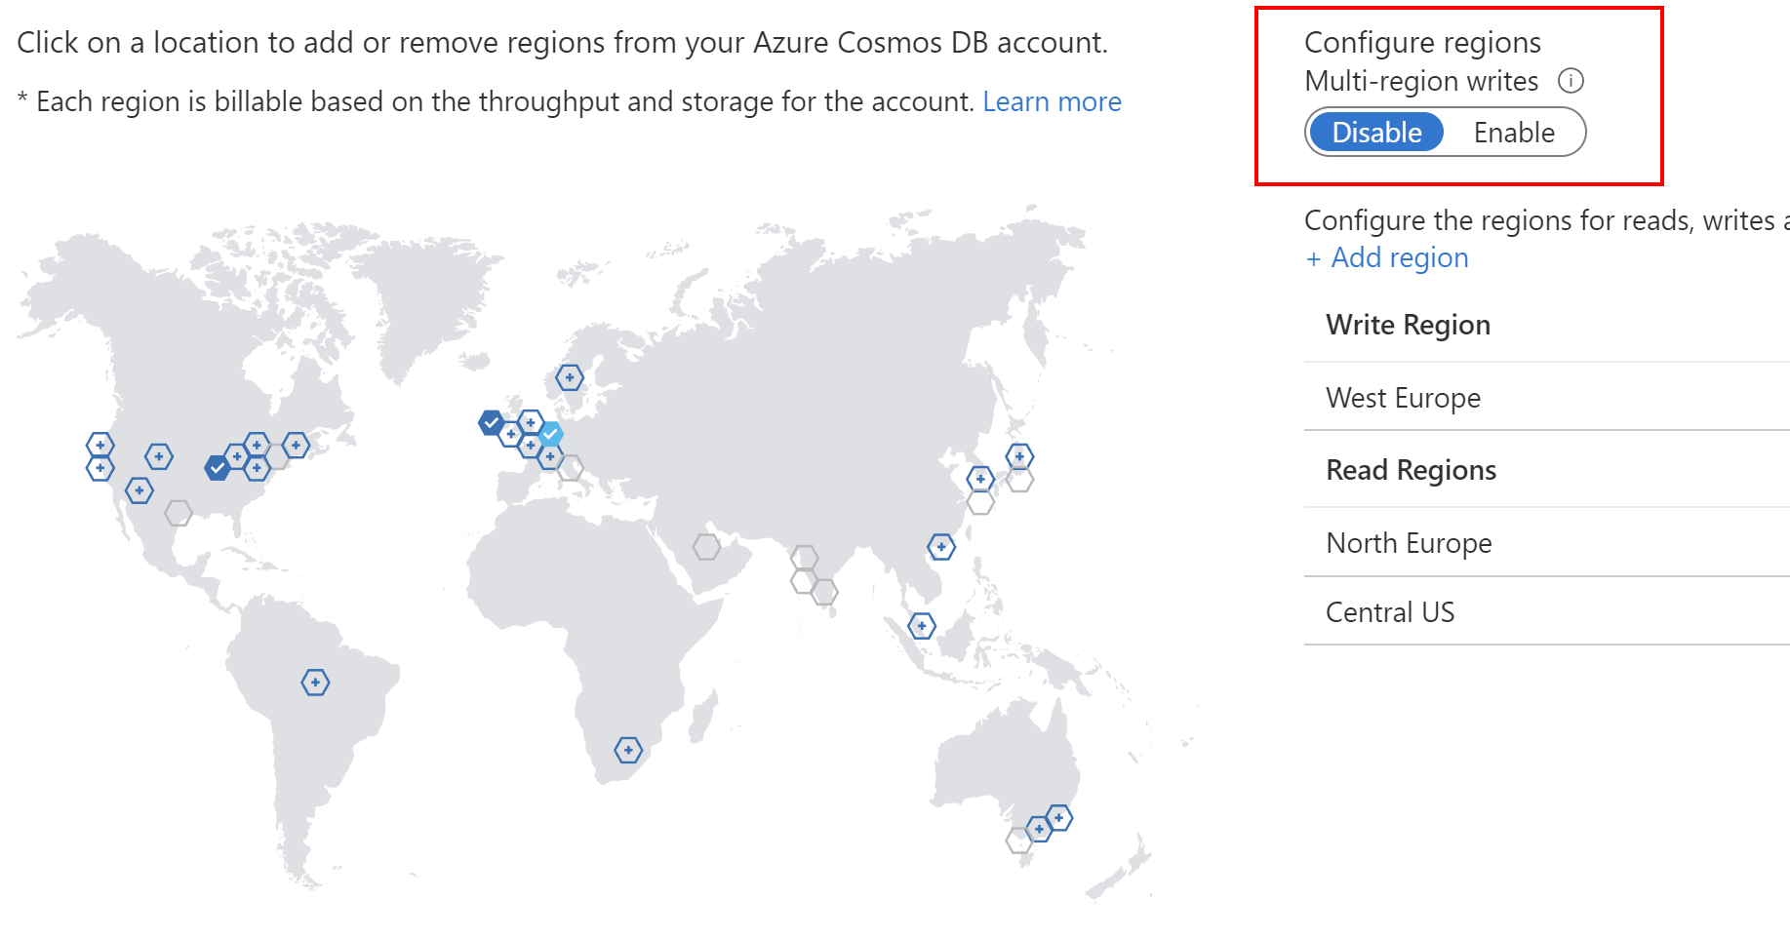
Write and Read Regions
When the database was first created, it was based on only one region
This default configuration defines the first (and only) region where a database accepts read and write operations.
When you distribute the database to more regions, the new regions automatically become read regions

Slide 4
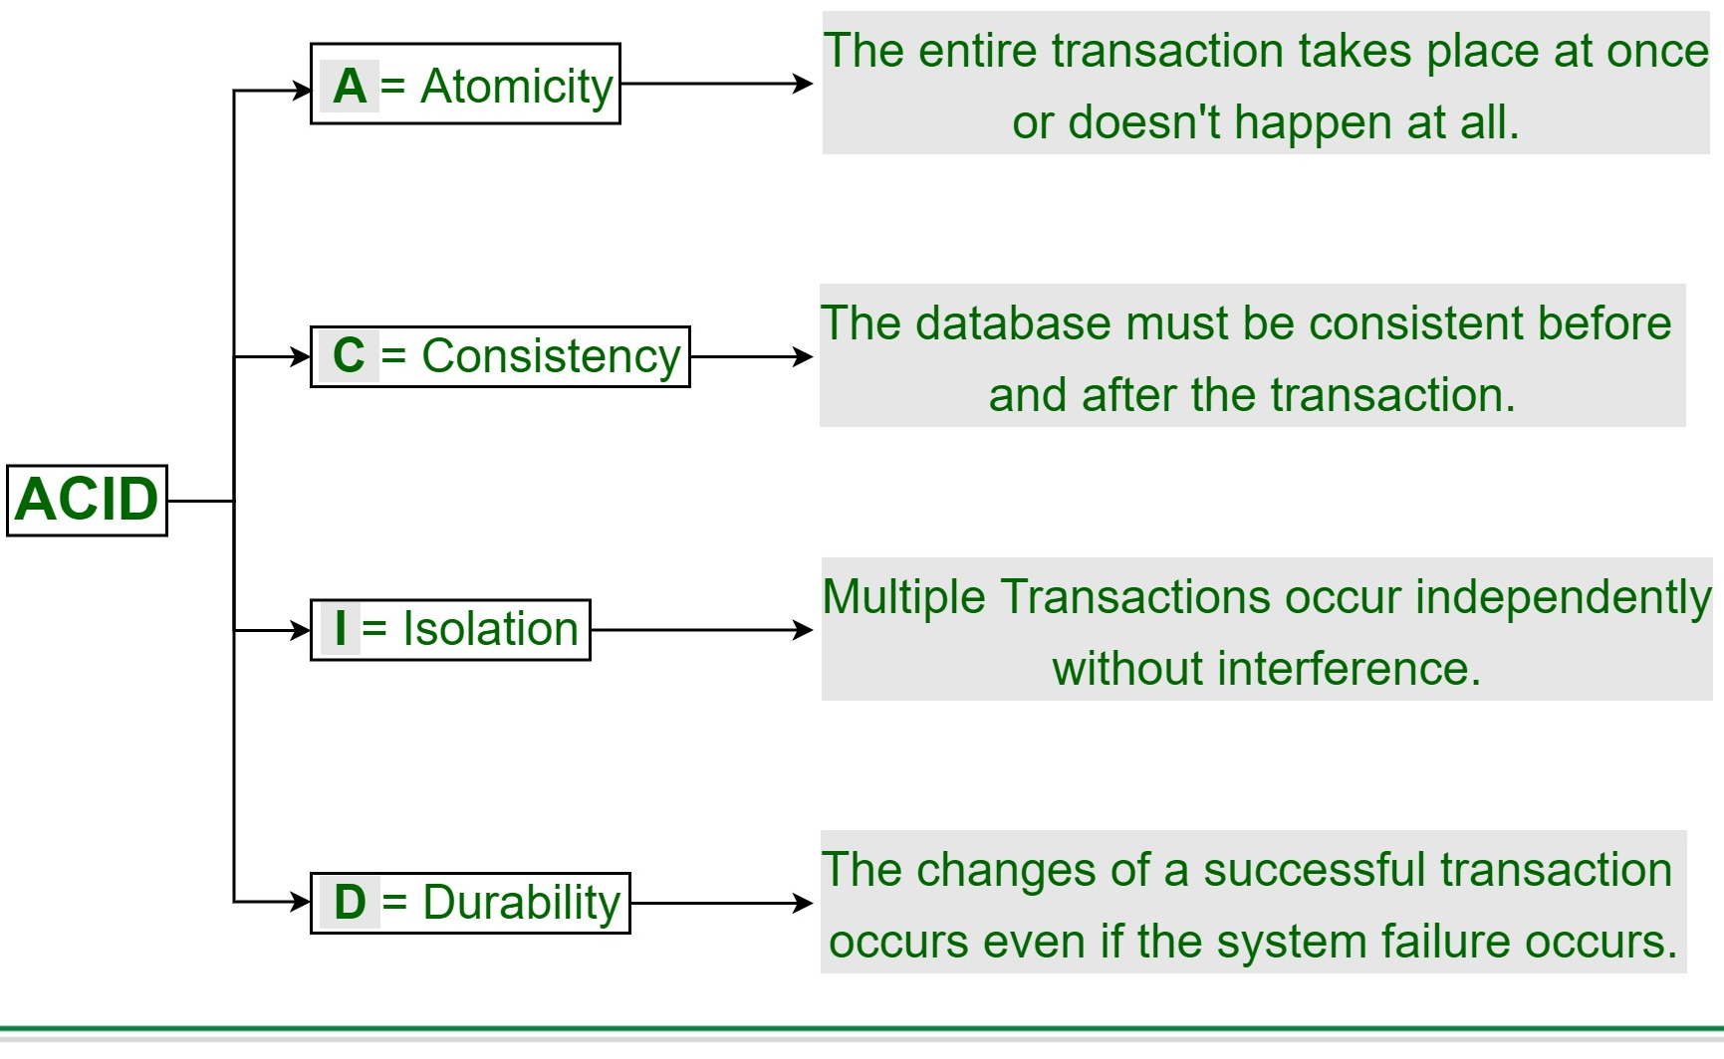
ACID Properties

Slide 5
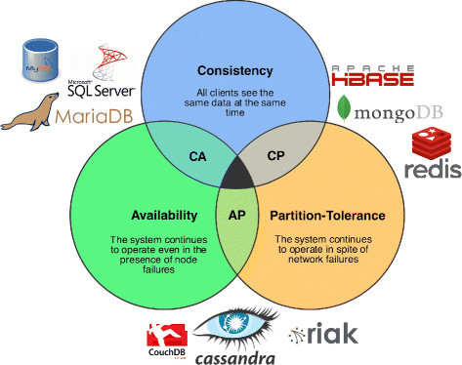
CAP Theoram

Slide 6
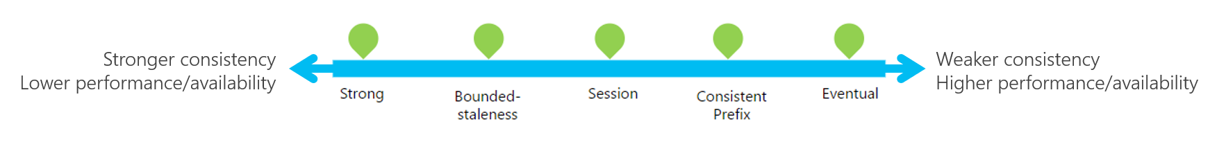
Consistency Models
Consistency defines the rules under which distributed data is available to users.
Azure Cosmos DB implements five different consistency models

Slide 7
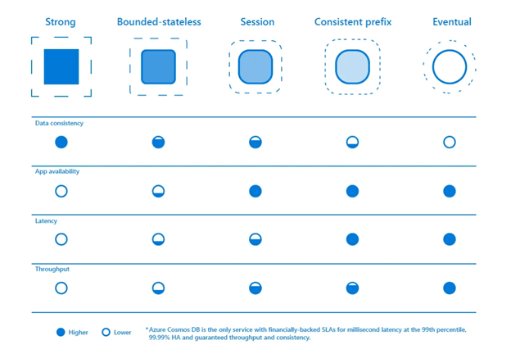
Consistency Models

Slide 8
Scope of Consistency
The granularity of consistency is scoped to a single user request.
A write request may correspond to an insert, replace, update, or delete Transaction
As with writes, a read/query transaction is also scoped to a single user request.

Slide 9
Strong Consistency Model

Slide 10
Eventual Consistency Model

Slide 11
Bounded Staleness Consistency Model

Slide 12
Session Consistency Model

Slide 13
Consistent Prefix Consistency Model

Slide 14
Consistency for Queries
By default, any user-defined resource would have the same consistency level for queries as was defined for reads
This is possible because indexes are updated synchronously
You can also change the index update strategy to be lazy
This will boost the performance of writes
When changing to lazy, regardless of the read consistency level, queries will have a consistency level of eventual

Slide 15
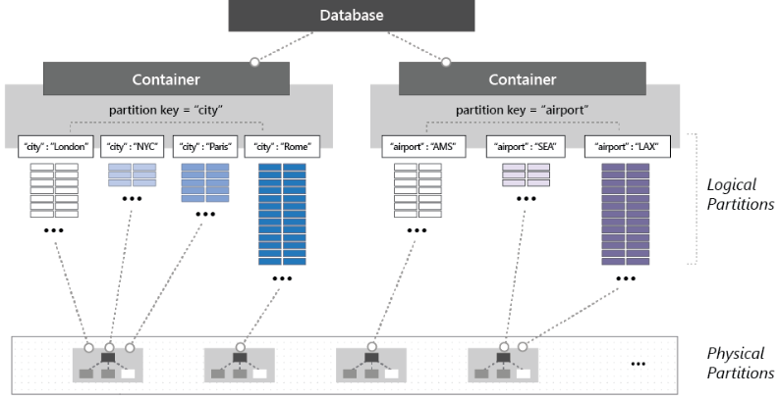
Understanding Partitioning

Slide 16
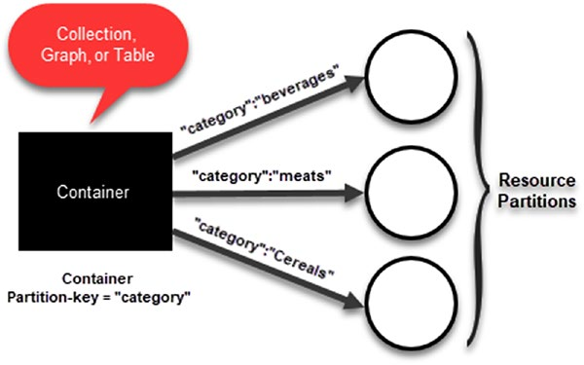
What Are Containers?
Containers are logical resources that group together one or more physical partitions.
Don’t have any restrictions in terms of amount of storage or throughput

Slide 17
How Does Partitioning Work?
Need to define a partition key and a row key for each item in your container.
These key combinations uniquely identify the item
The partition key determines the logical partition for your data
Choosing the right partition key is crucial

Slide 18
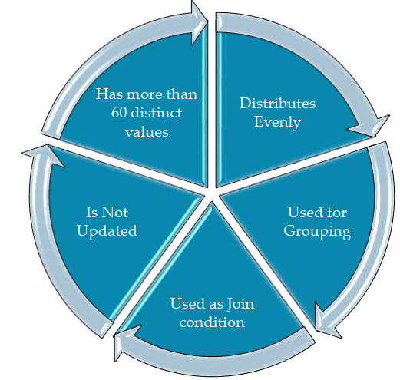
Designing for Partitioning
There are two key considerations when choosing the partition key

Slide 19
Understanding Throughput
Azure Cosmos DB has predictable performance
This is achieved by provisioning a specific amount of request units (RU) per second
This amount is what is called throughput.
This means that you will be billed by how much reserved throughput you have as opposed to how much you actually use

Slide 20
Specifying Request Unit Capacity
When defining a new collection, you need to configure the specific number of request units per second you want reserved for the container.
The reserved throughput can be between 400 and 10,000 request units per second.
Based on this number, Azure Cosmos DB allocates physical partitions to host the collection and it will manage the data across partitions as it grows.

Slide 21
Estimating Throughput
Refer:
https://azure.microsoft.com/en-gb/products/cosmos-db/

Slide 22
Implementing Security
Encryption at Rest
Firewall Support
Securing Access to Data

Slide 23
Supported APIs
Azure Cosmos DB supports several APIs for resource and data management
Several software development kits (SDKs)
At its core is the REST API, which provides a foundation for all actions
There are also other APIs such as
DocumentDB
Mongo DB
Apache Cassandra
Table
Graph

Slide 24
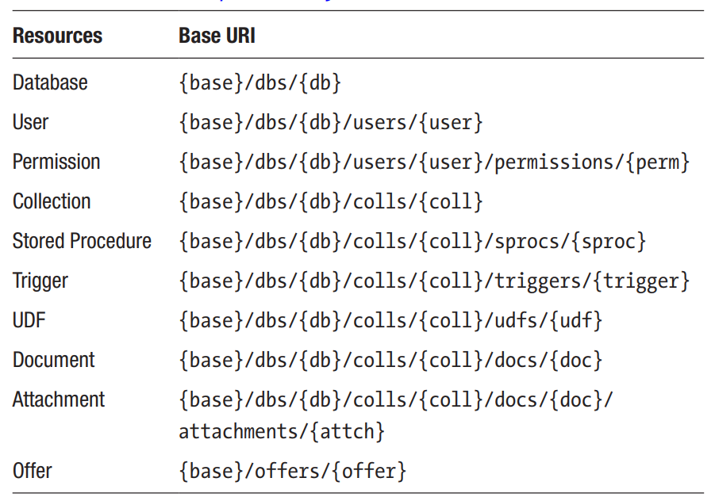
Azure Cosmos DB REST API
The REST API interacts with Azure Cosmos DB using the HTTP protocol.

Slide 25
DocumentDB API
The DocumentDB API is built on top of the REST API and is implemented in several languages and platforms including .NET, Java, NodeJS, JavaScript, and Python via their respective SDKs.
var dbUrl = "https://productcatalog.documents.azure.com/dbs";
var authKey = "the primary or secondary key for the account";
client = new DocumentClient(new Uri(dbUrl),authKey);
await client.CreateDatabaseAsync(new Database { Id = "Products" });

Slide 26
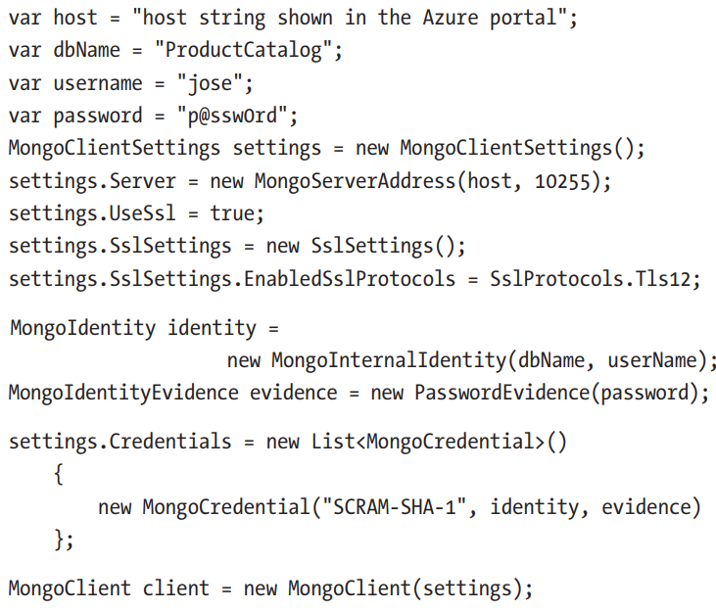
MongoDB API
With the MongoDB API, you can leverage your knowledge of MongoDB
In most cases, an existing MongoDB application would work without any code changes.

Slide 27
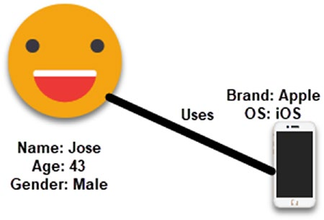
Graph API
Graphs are very useful to understand a wide range of datasets in different fields such as science and business

Slide 28
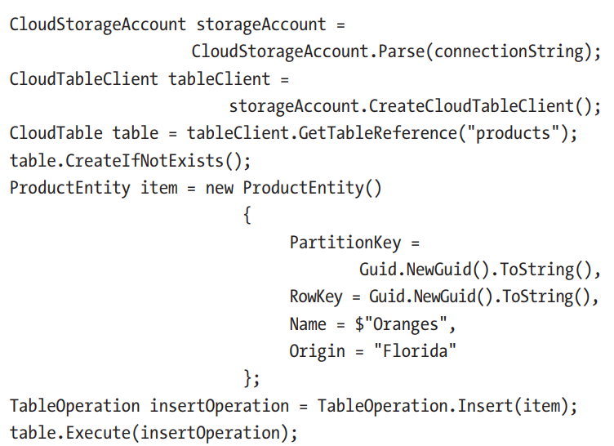
Table API
An Azure Cosmos DB account implementing the Table API provides the same functionality as Azure Table storage
With the benefits of scalability and throughput from Cosmos DB.

Slide 29
Thank You

